Slide 1
RNA Secondary Structure
Prediction
● Using Context Free Grammars ●
Ali Ahmadi Esfidi

Slide 2
01
Overview
02
Stochastic Context Free Grammar
CONTENTS
03
Columns Probablity
04
Algorithms
05
Implementation
2/26

Slide 3
01
Overview

Slide 4
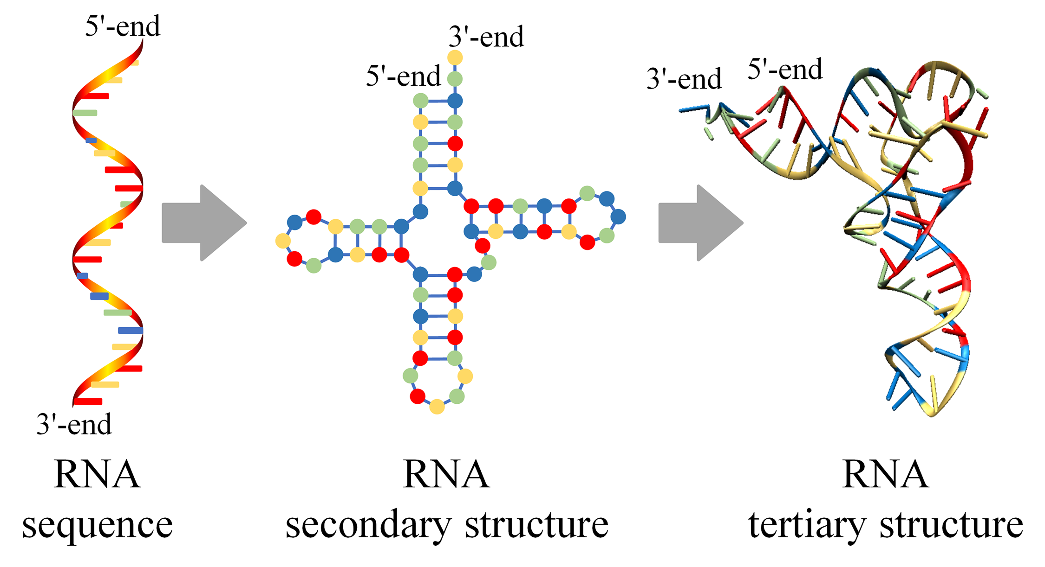
RNA Secondary Structure
4/29

Slide 5
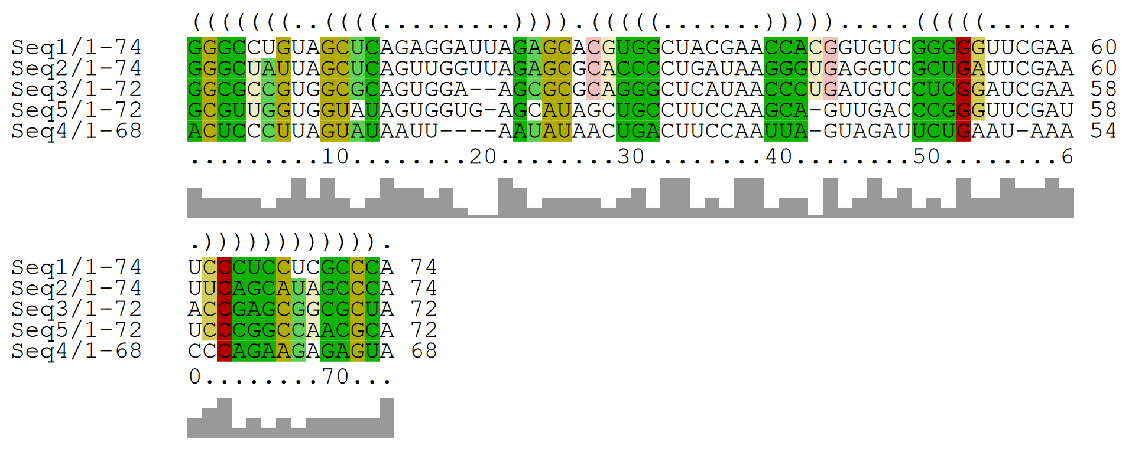
Input And Output
Using Stochastic Context Free Grammar !!
5/29

Slide 6
02
Stochastic Context Free Grammar

Slide 7
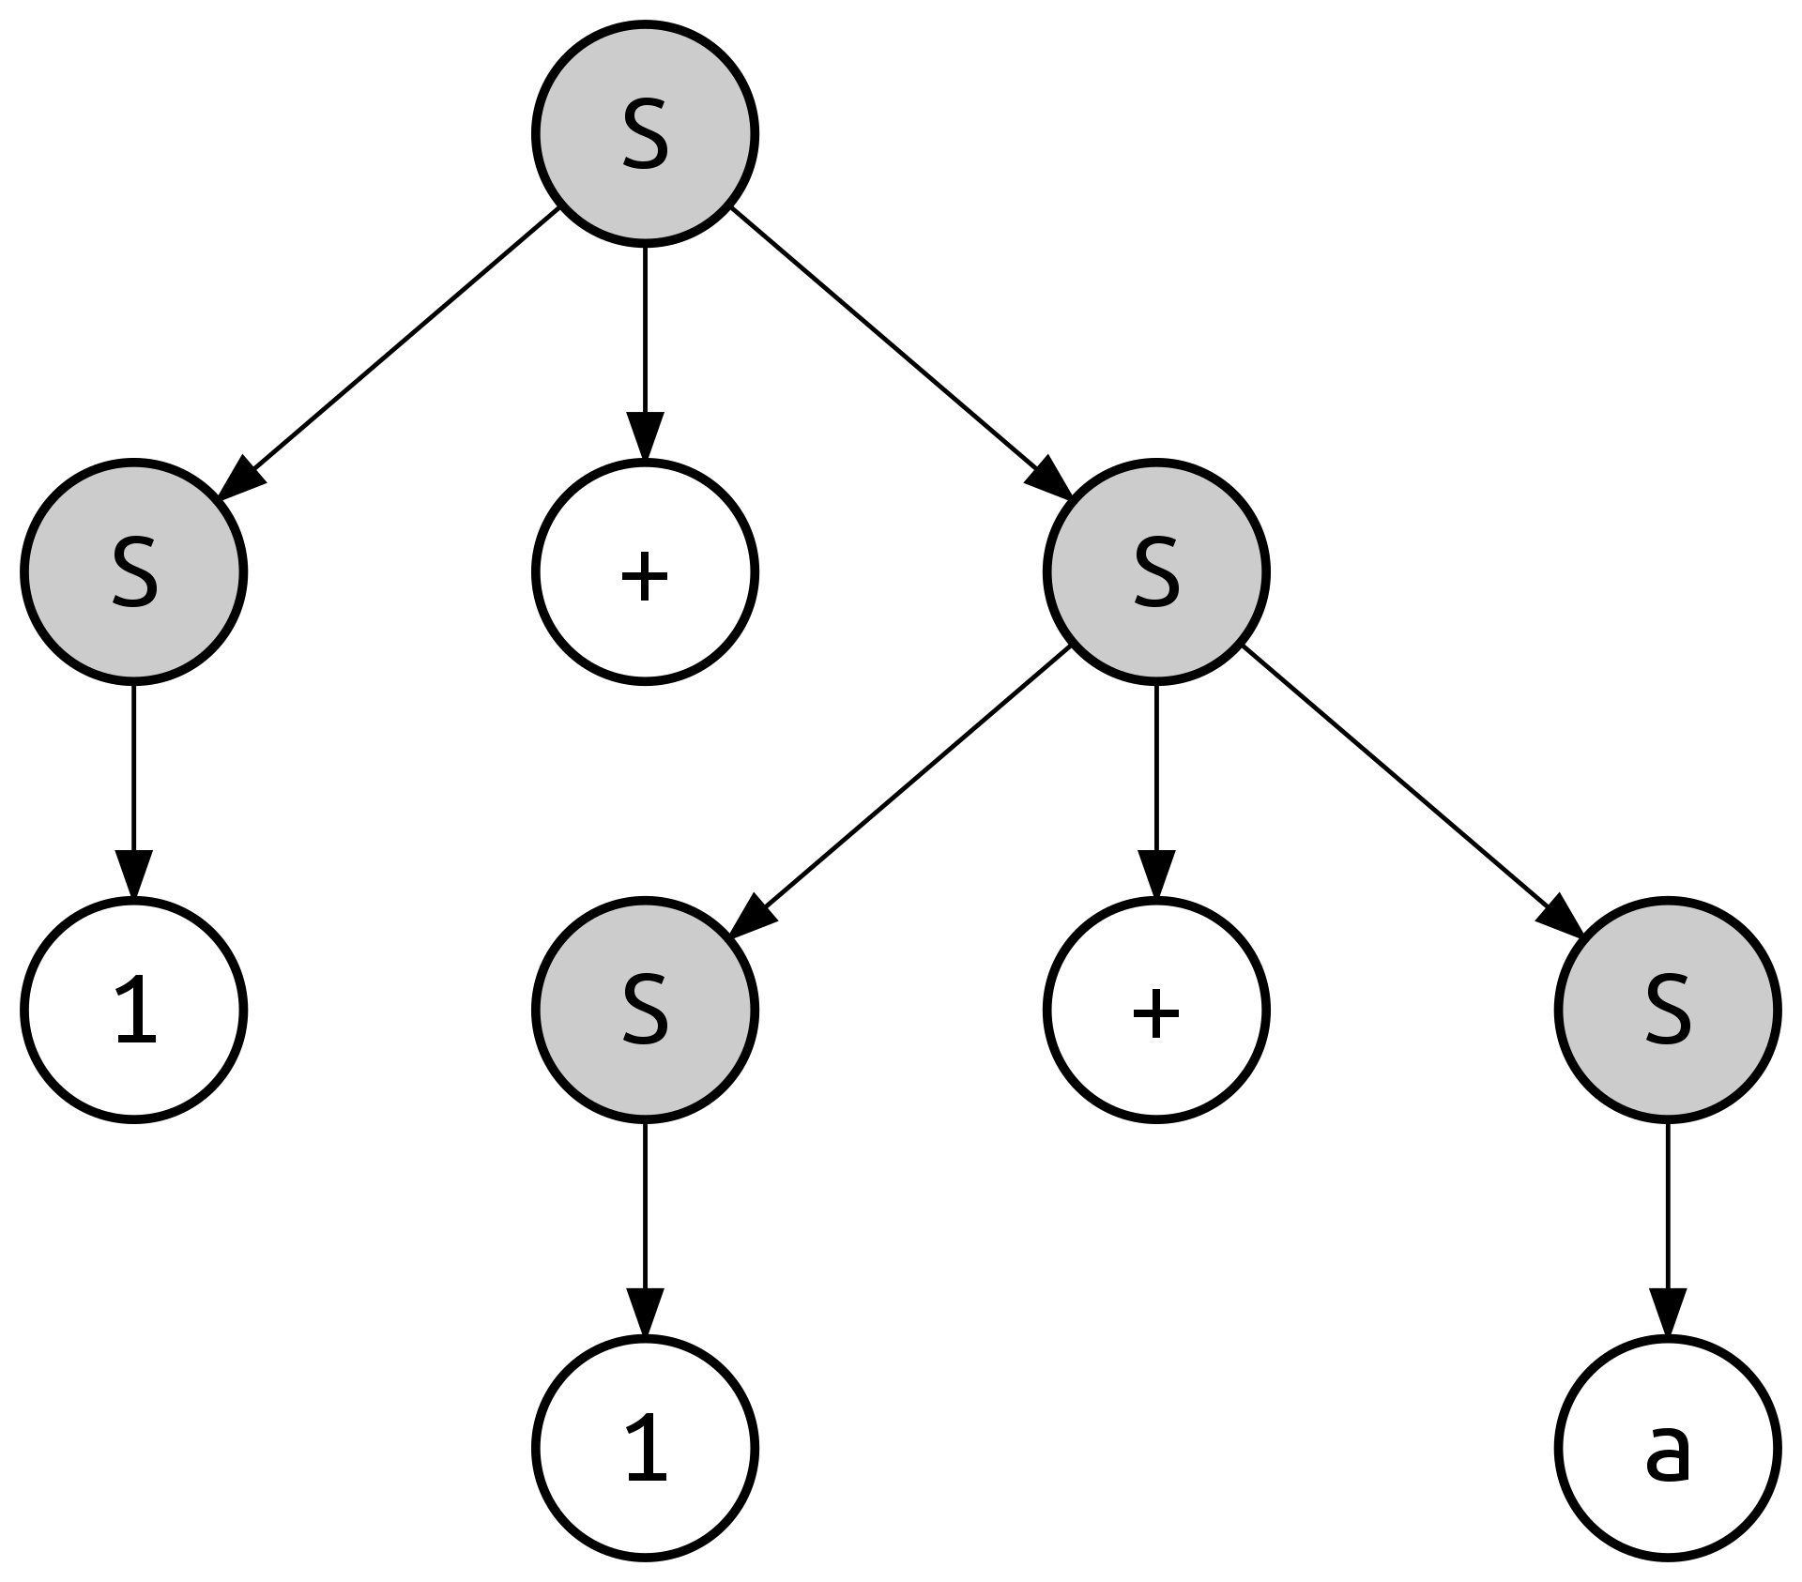





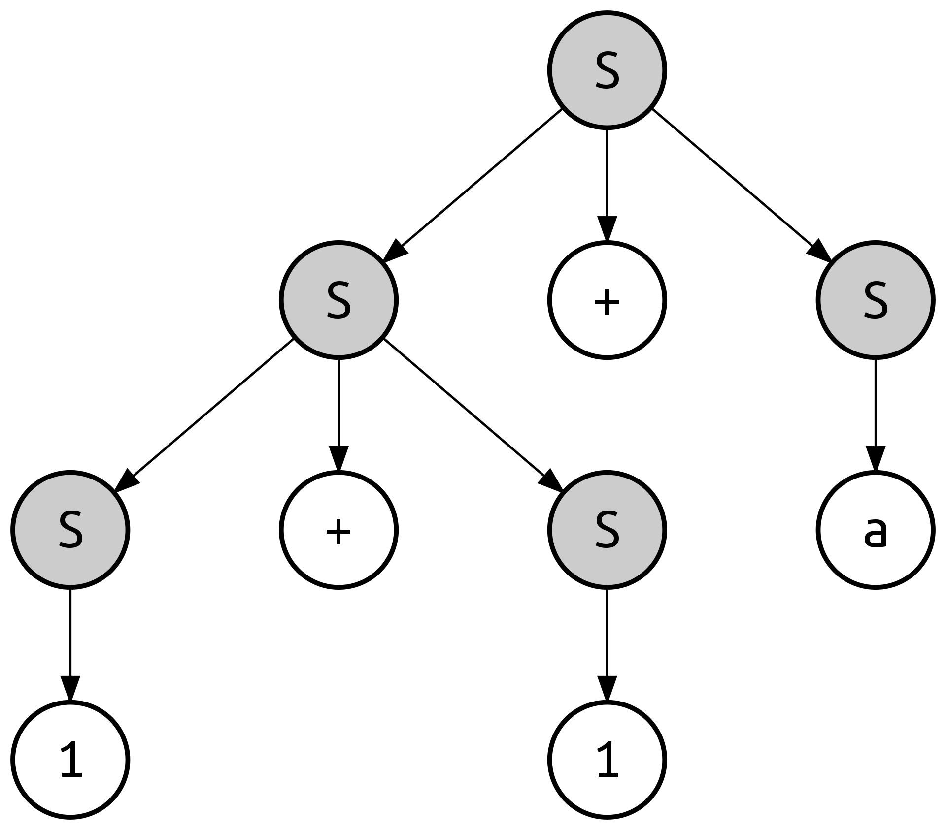

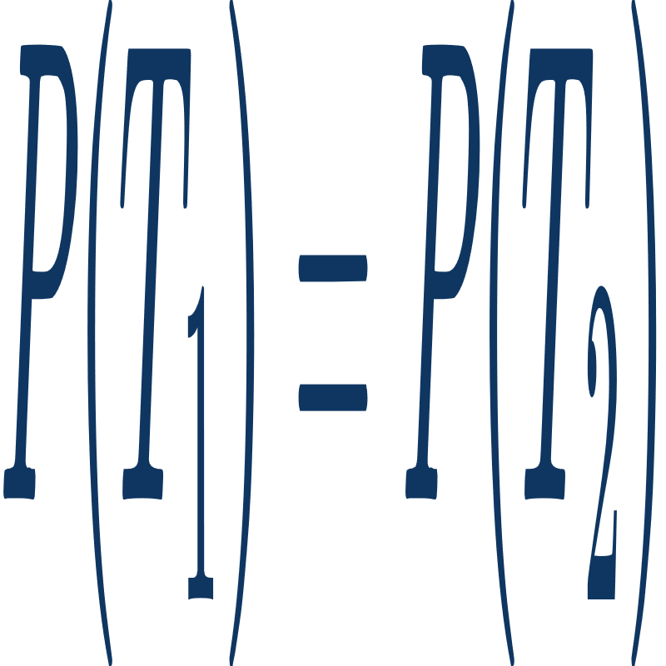
Stochastic Context Free Grammar
+ P
60%
30%
10%
= 0.6 * 0.6 * 0.3 * 0.3 * 0.1
Not Always true in PCFG
7/26

Slide 8
Back To The Problem
A
A
A
A
A
A
A
A
A
C
A
A
A
A
G
A
A
A
A
U
A
A
A
C
A
Terminals
?!
->
...
Thus, we need to calculate all possible columns probablity, in two state of being single base or pair base.
8/26

Slide 9
03
Columns Probablity

Slide 10
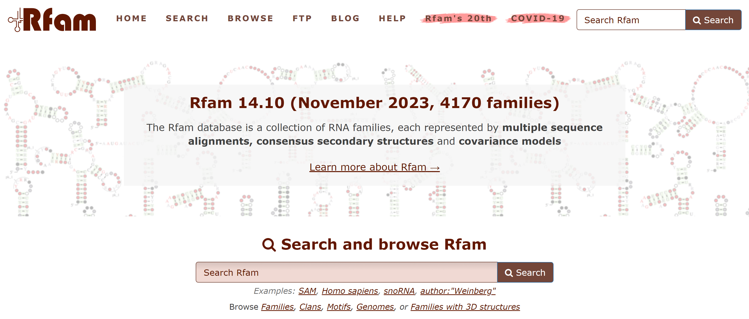
Primary Data
10/29

Slide 11
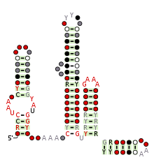
Primary Data
Family name : LOOT (RF03000)
Number of taxa : 368
Number of sites : 203
File format : Stockholms
11/29

Slide 12
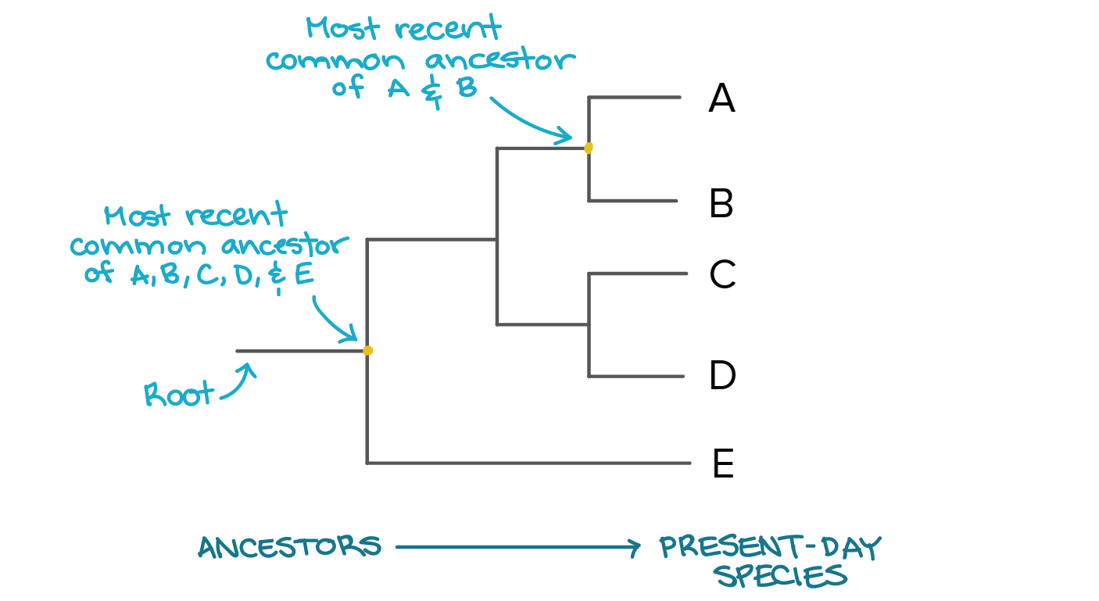
Phylogenetic Tree
12/29

Slide 13
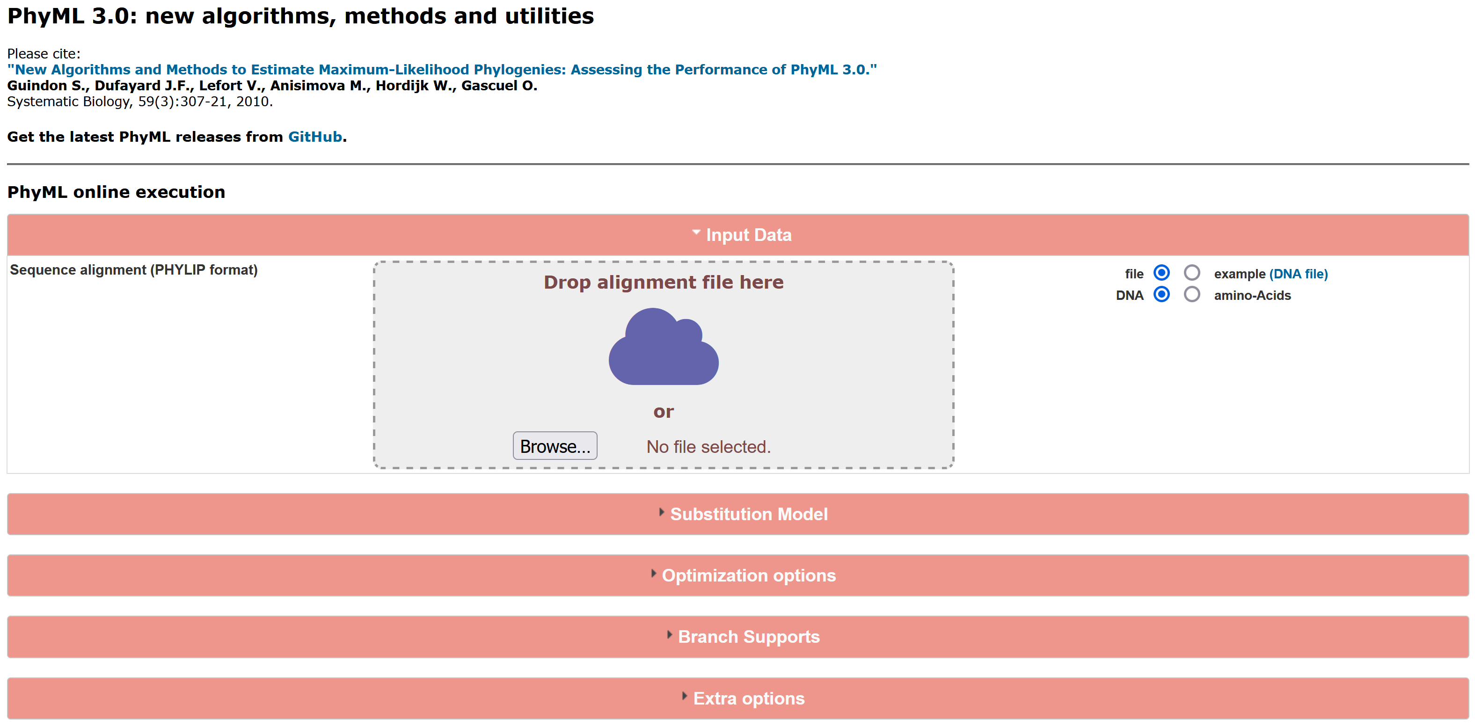
PhyML
13/29

Slide 14
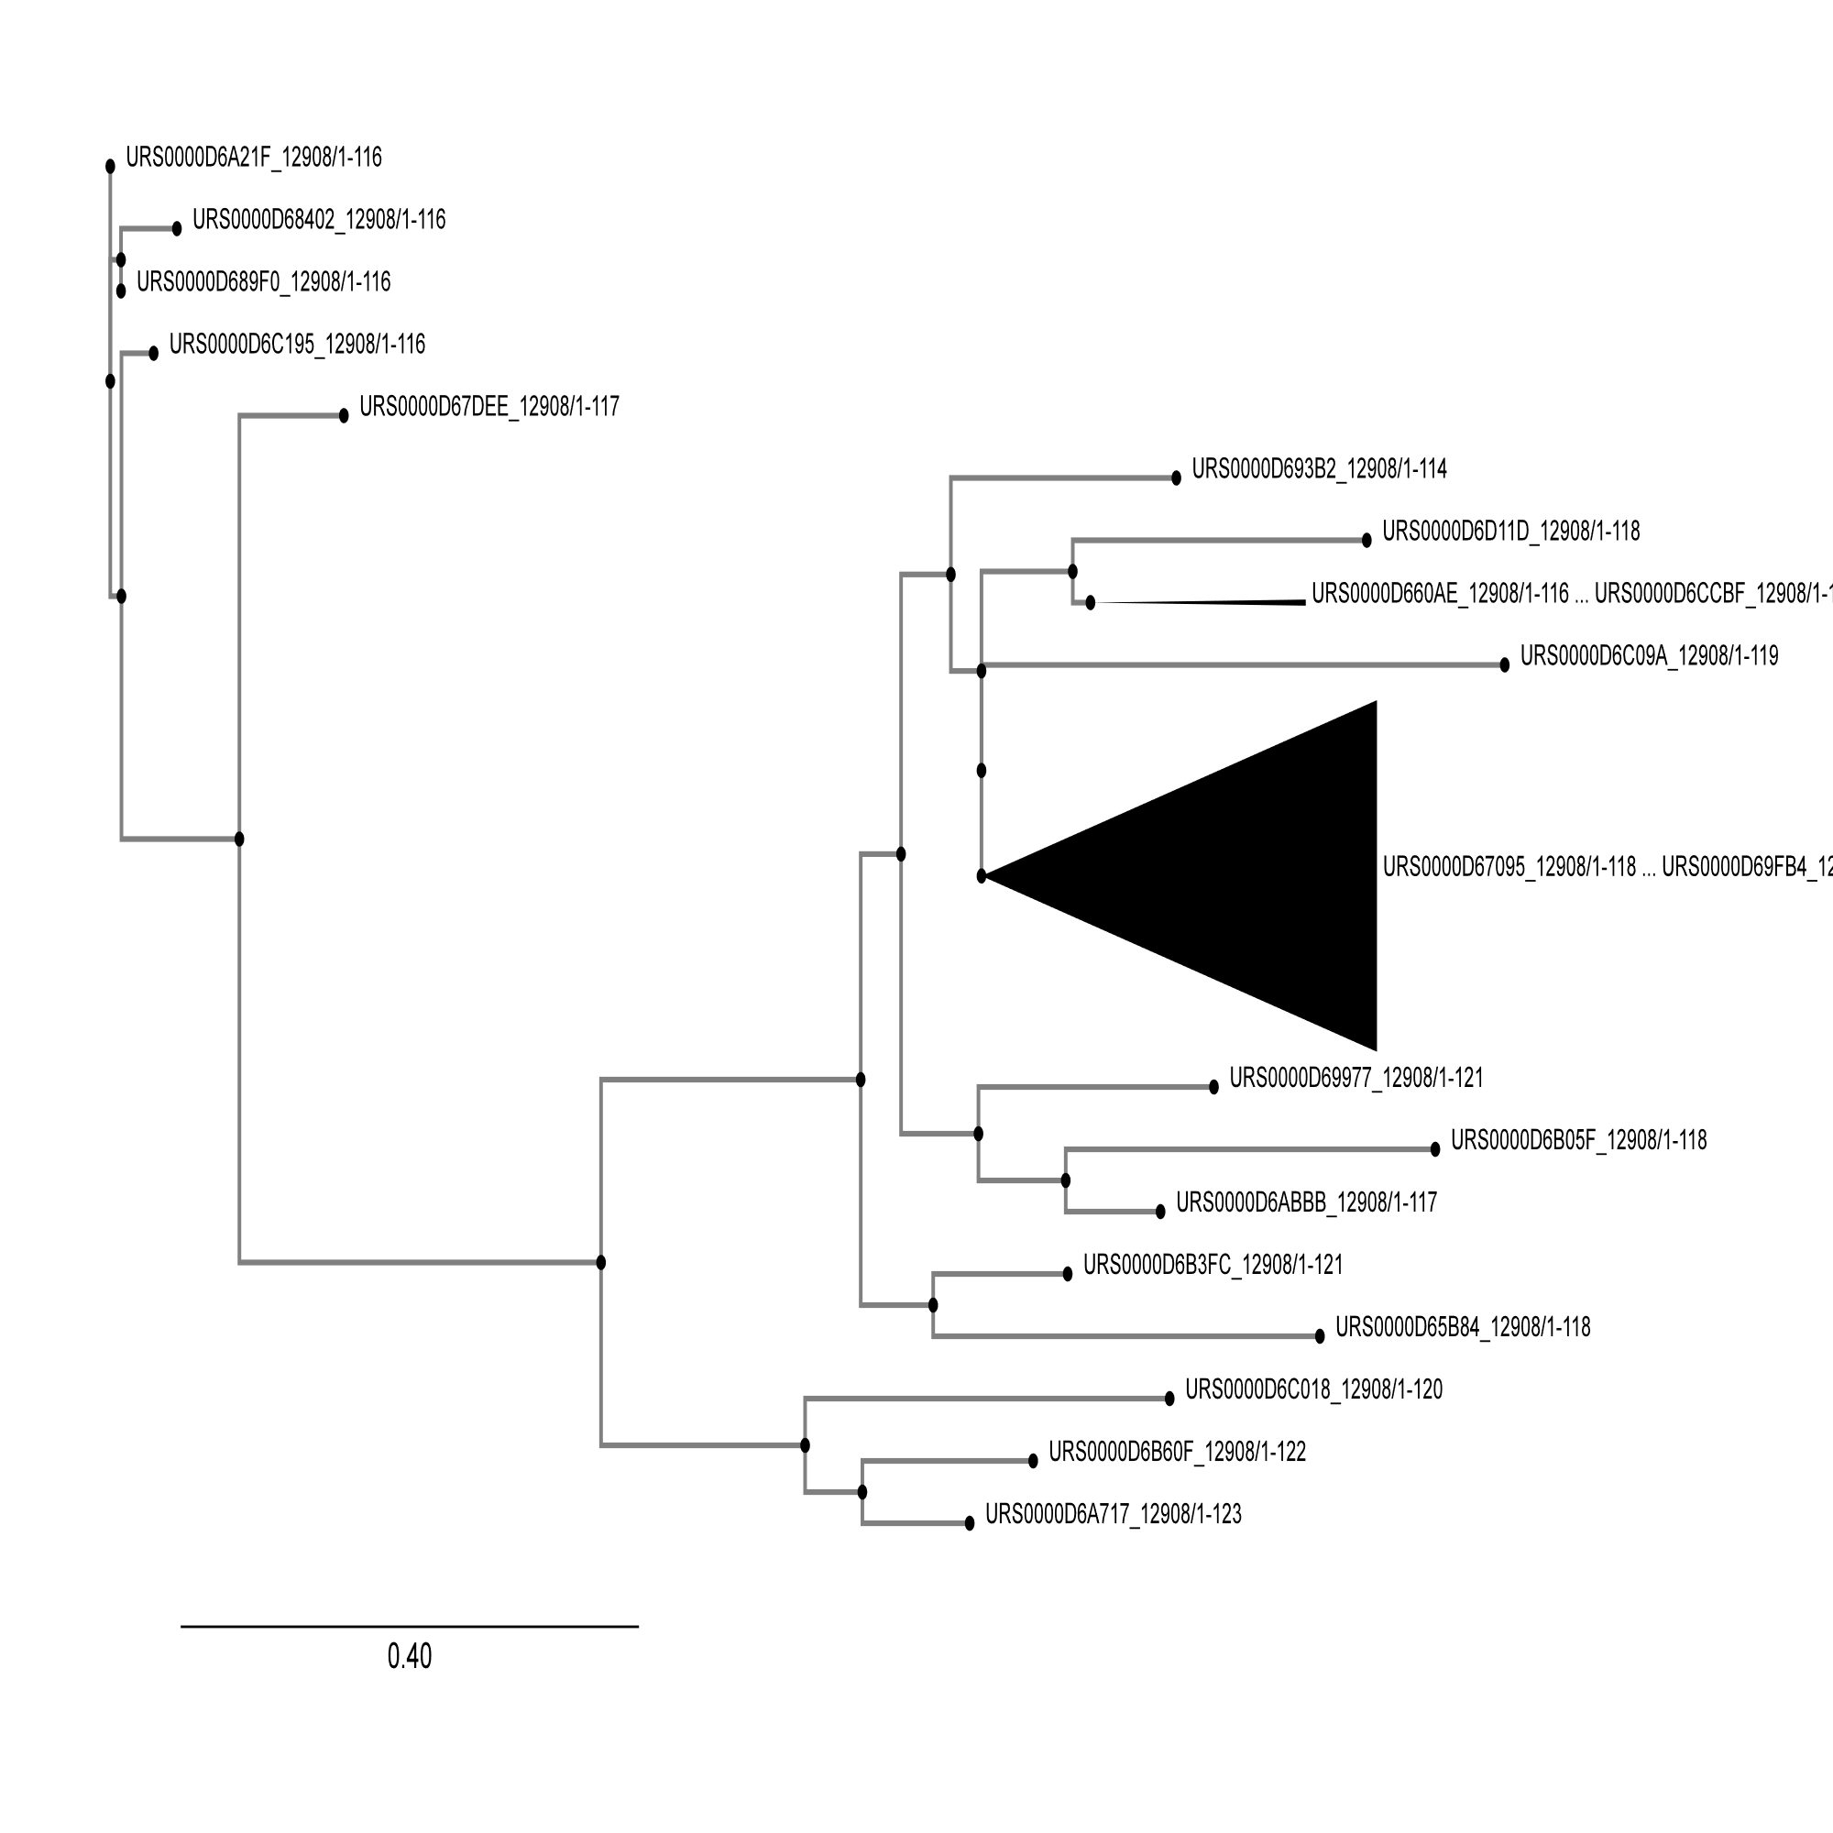
Phylogenetic Tree
LOOT (RF03000)
14/29

Slide 15
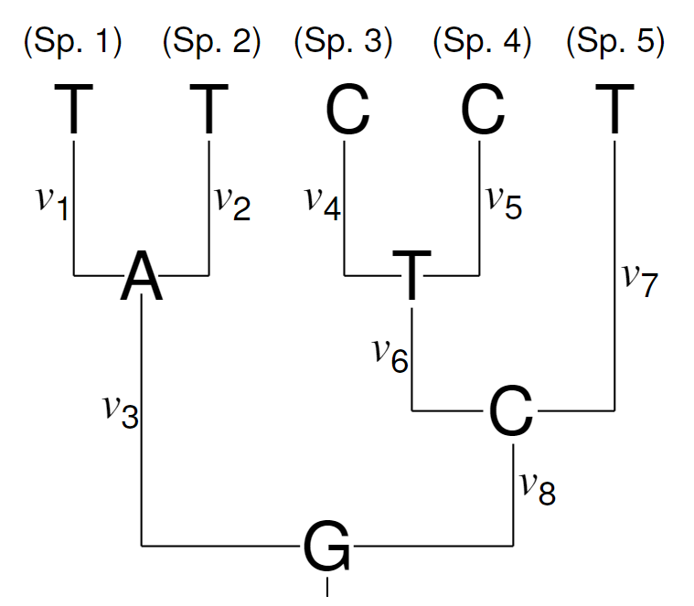
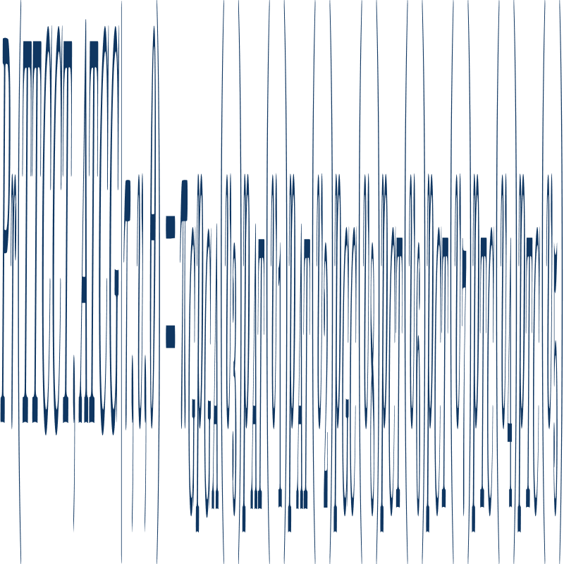
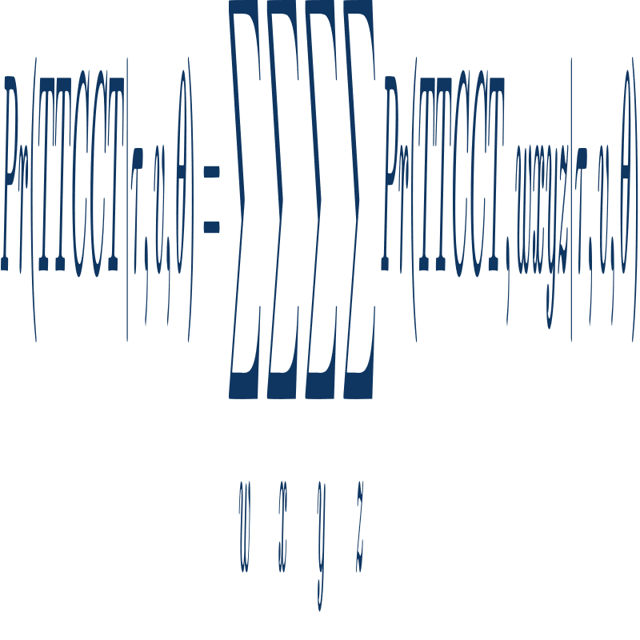
Columns Probablity
π: frequencies
p: mutation probablity
15/29

Slide 16
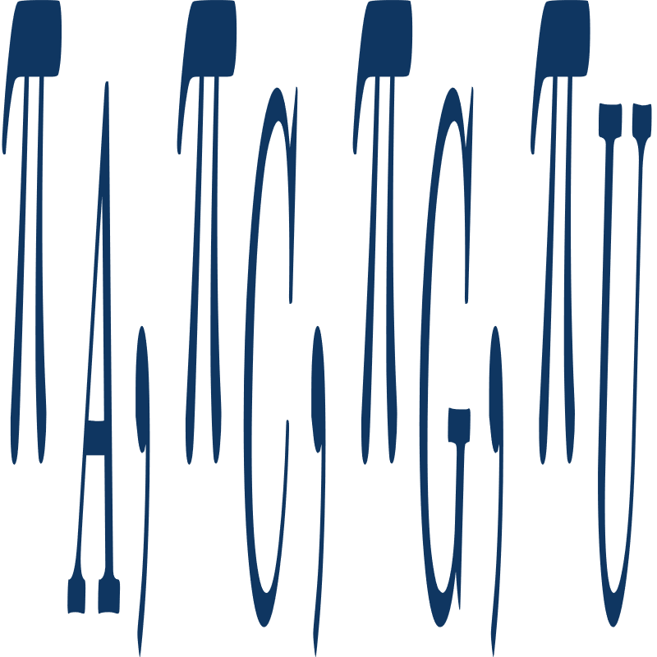
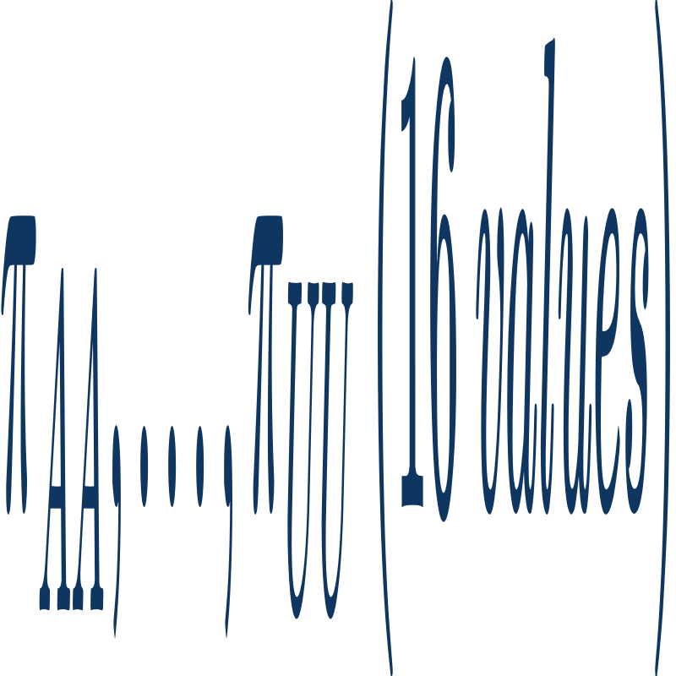
Calculating Frequencies
Non-pairing Bases:
Counting A, C, G and U
Finding each ratio to all non-pairing bases
Pairing Bases:
Counting AA, AC, AG, AU and ...
Finding each ratio to all base pairs
16/29

Slide 17

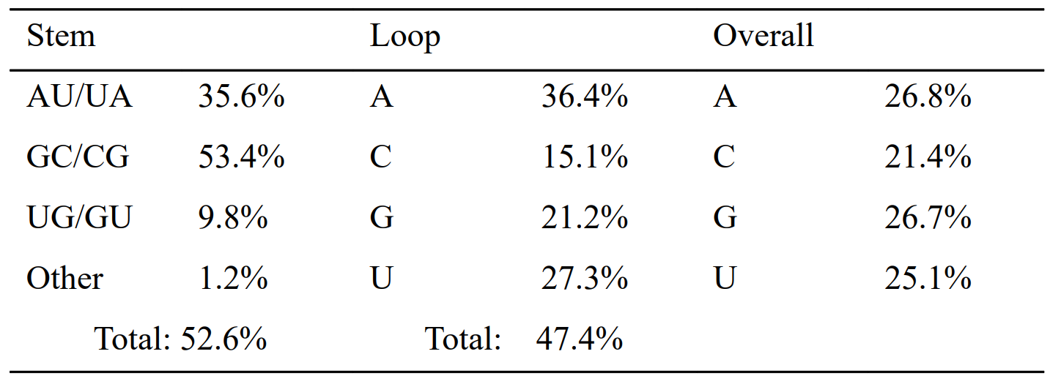
Calculating Frequencies
Total Ratio:
Ratio of both pairing/non-pairing bases to all bases.
Example:
(Using later)
17/29

Slide 18
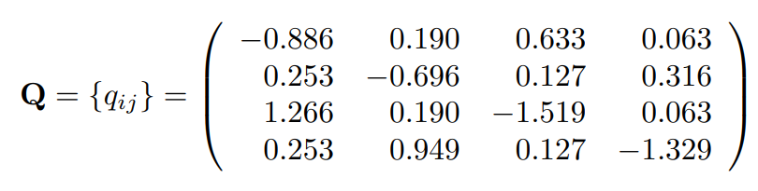
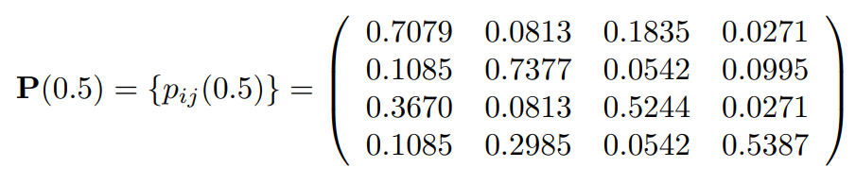
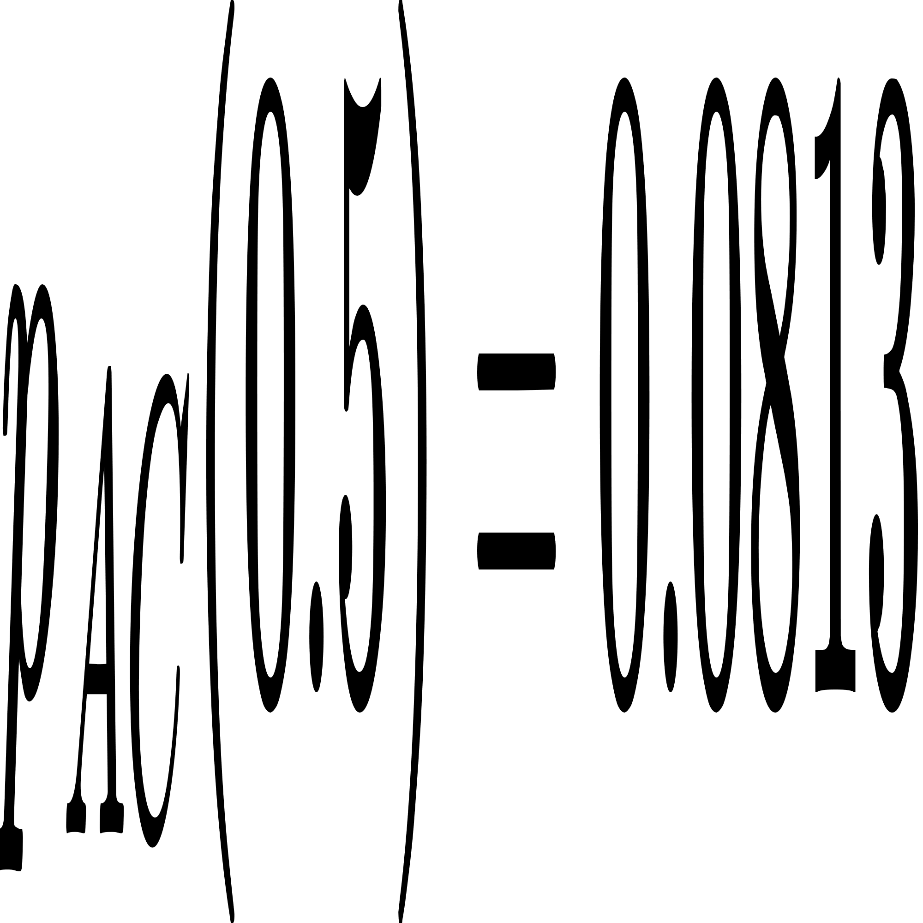
Calculating Mutation Probablities
Steps
Mutation rate matrix (Q)
Mutation probablity matrix (P)
Mutation probablity
Example
1)
2)
3)
18/29

Slide 19
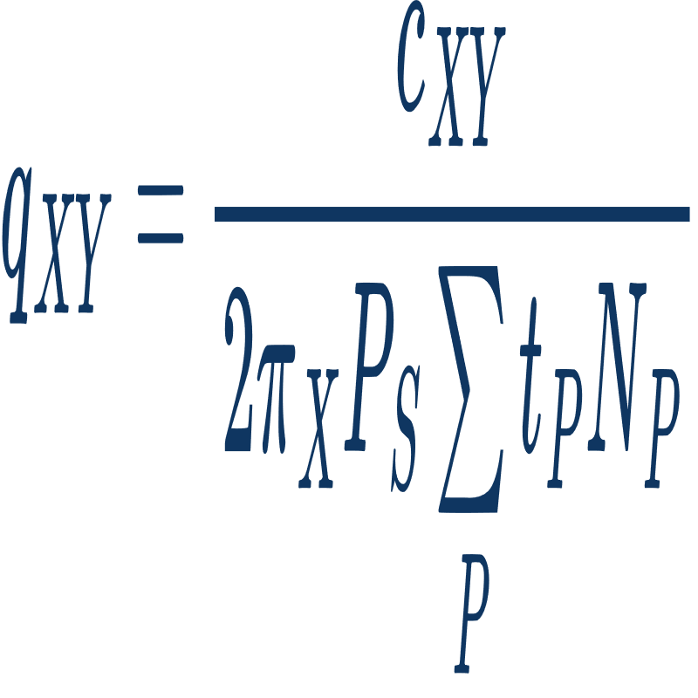
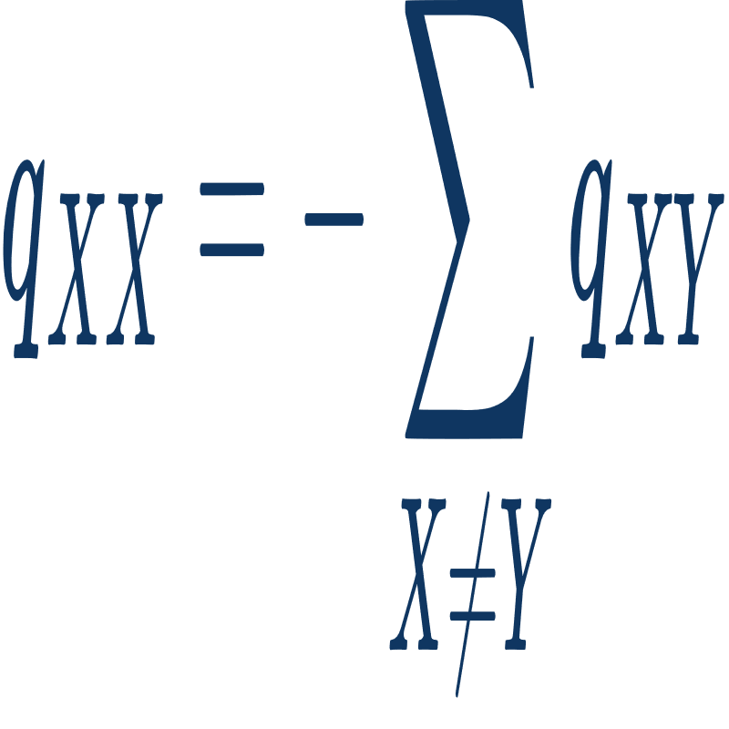
Calculating Mutation Probablities
In Q matrix for X ≠ Y:
( P: pairs with at least 85% simularity )
Other Q matrix values:
19/29

Slide 20
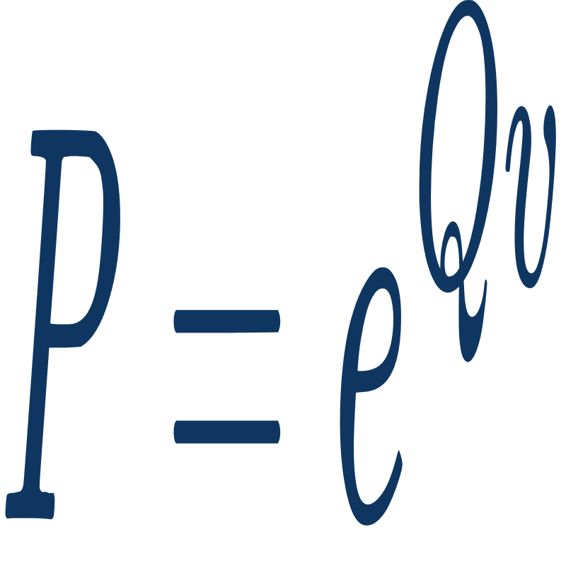
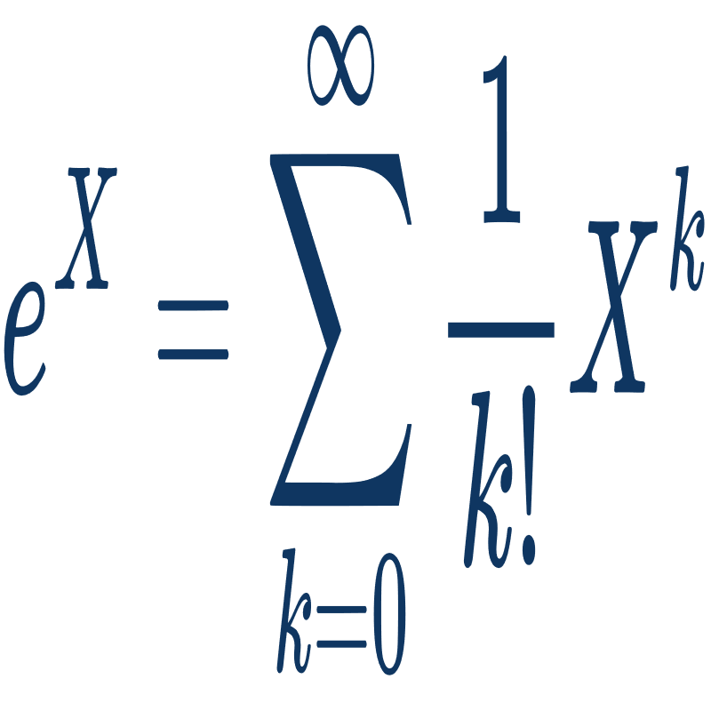
Calculating Mutation Probablities
Mutation probablity matrix (P):
Exponential of matrix:
Select probablity :)
20/29

Slide 21
04
Algorithms

Slide 22
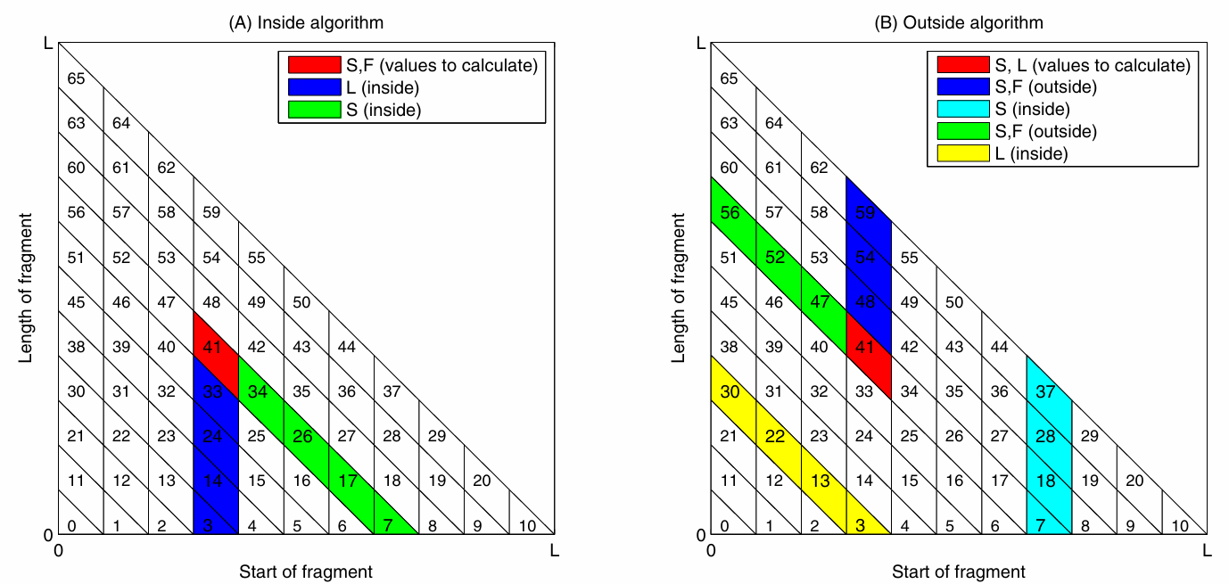
Inside Outside Algorithm
22/29

Slide 23
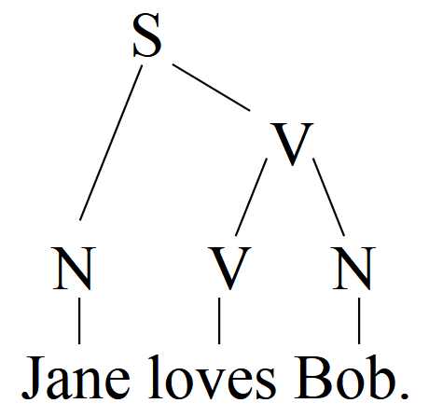
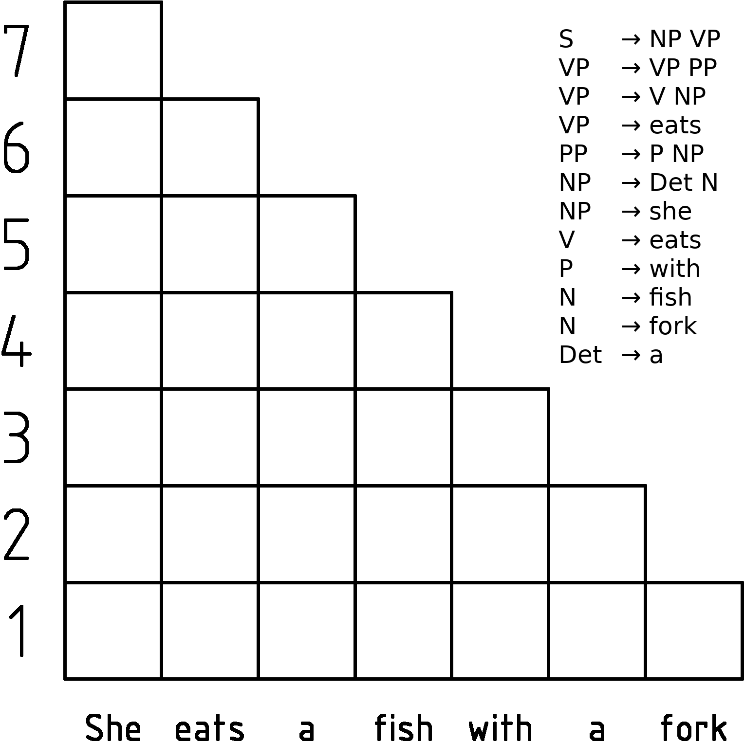
Cocke Younger Kasami Algorithm
23/29

Slide 24
05
Implementation

Slide 25
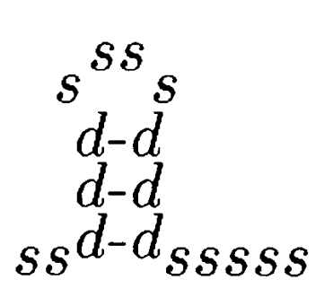
Inside Outside Algorithm
S -> L S
S -> Dm Dr
F -> Dm Dr
F -> L S
L -> Dm Dr
Dm -> Dl F
S -> s
L -> s
Dl -> d
Dr -> d
S -> L S 0.92
S -> Dm Dr 0.02
F -> Dm Dr 0.82
F -> L S 0.18
L -> Dm Dr 0.05
Dm -> Dl F 1.0
S -> s 0.06
L -> s 0.95
Dl -> d 1.0
Dr -> d 1.0
... ((((((................)))))) ...
(In Stockholm File)
+
=
Terminal ‘s’ stands for a single base, and ‘d’ stands for a pairing base.
25/29

Slide 26
Extending Grammmar
After calculating column probablities (Counting gap as 5th nucleotide):
S -> L S 0.92
S -> Dm Dr 0.02
F -> Dm Dr 0.82
F -> L S 0.18
L -> Dm Dr 0.05
Dm -> Dl F 1.0
S -> s 0.06
L -> s 0.95
Dl -> d 1.0
Dr -> d 1.0
S -> L S 0.92
S -> ('A','A') 0.00847
S -> ('C','A') 0.00015
S -> ('G','A') 0.00017
S -> ('U','A') 0.00018
S -> ('A','C') 0.00014
S -> ('C','C') 0.00294
S -> ('G','C') 0.00005
...
+
Columns Probablity
=
By running CYK on extended grammar, we can get the secondary structure by checking which rule ended to terminal ( Dl -> ‘(’ , Dr -> ‘)’ , others -> ‘.’ )
26/29

Slide 27
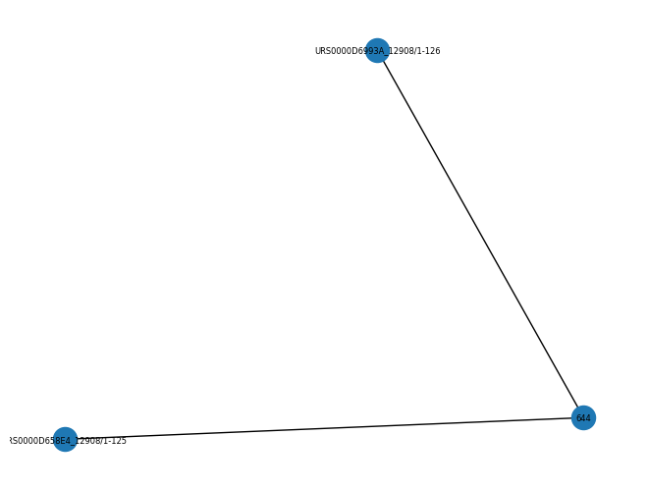
Example
Input:
"URS0000D658E4_12908/1-125"
"URS0000D6993A_12908/1-126"
Output:
(((((((((.(((((((...........................))))))))))))))))............(((((((((((((((((((((((((.........................))))))))))))))))))))))))).((((((.(((.......))))))))).((((((................))))))
27/29

Slide 28
References
Lectures:
Secondary Structure Prediction (Knudsen B. and Hein,J. - 1999)
Secondary Structure Prediction (Knudsen B. and Hein,J. - 2003)
Calculating Likelihoods on Phylogenetic Trees (John P. Huelsenbeck - 2012)
The Inside-Outside Algorithm (Michael Collins)
Books:
RNA Sequence, Structure and Function (Jan Gorodkin)
Biological Sequences Analysis (R. Durbin)
28/29

Slide 29
Thanks For Attention

